Slide 1
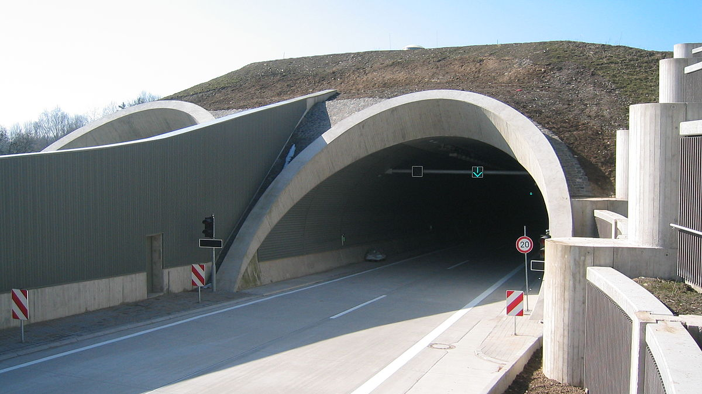
Vehicle Detection and Classification

Slide 2
Motivation: Safety
Detect and Classify vehicles entering and exiting a tunnel
Keep track of vehicles that reside in a tunnel
Vehicle type can give additional information to rescue workers, eg. Truck, bus, car.

Slide 3
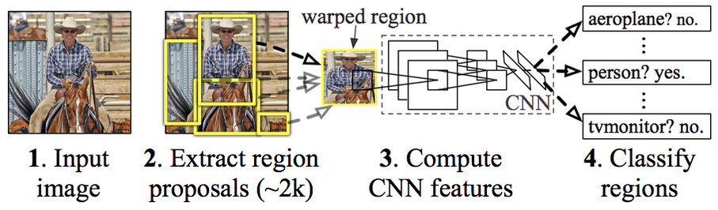
Utilizing Tensorflow's Object Detection API
Transfer-learning
Region Proposal (Faster R-CNN)
Trained on COCO (Common Objects in Context) dataset – more than 200.000 annotated images, spanning over 80 classes
Requires less data for training
R-CNN Architecture

Slide 4
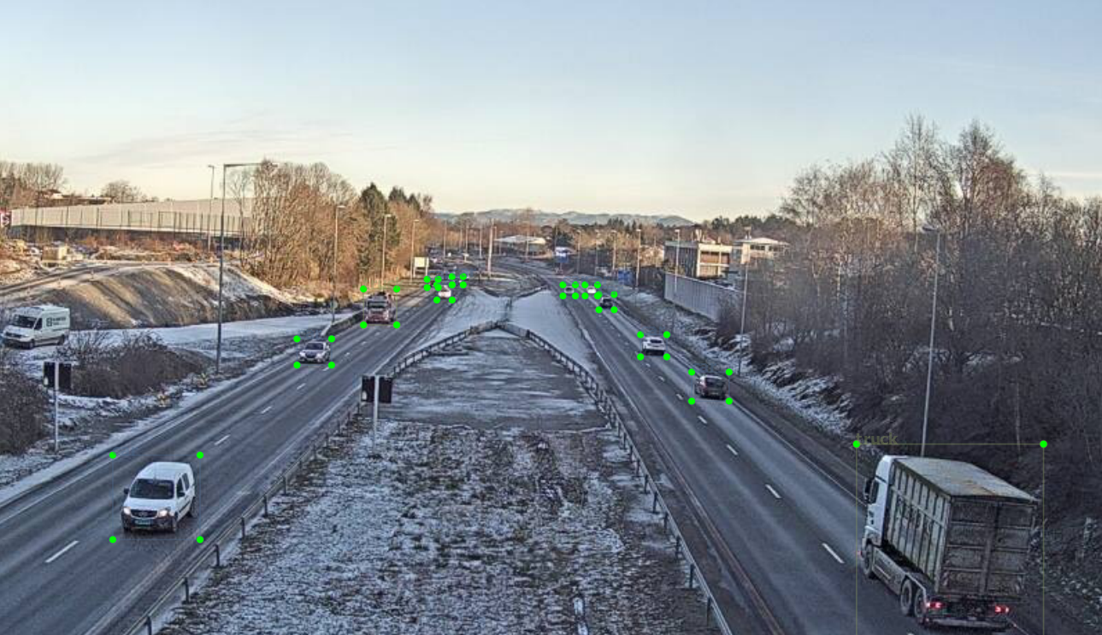
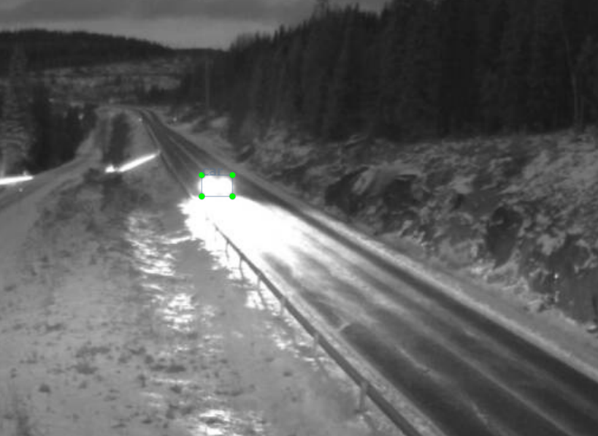
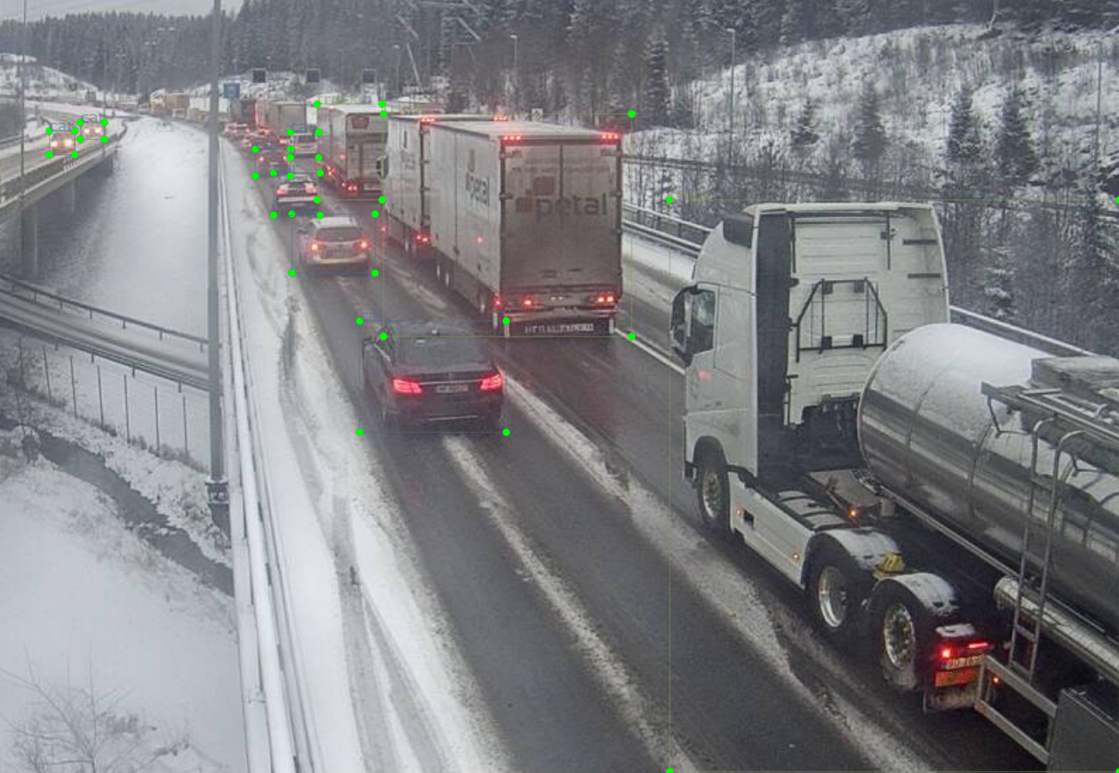
Challenges
Collecting "enough" data
Overfitting
Illumination
Occlusion
Background noise

Slide 5
Further Work
Background subtraction, extract foreground objects and classify them with a general CNN. (with transfer-learning)

Slide 6
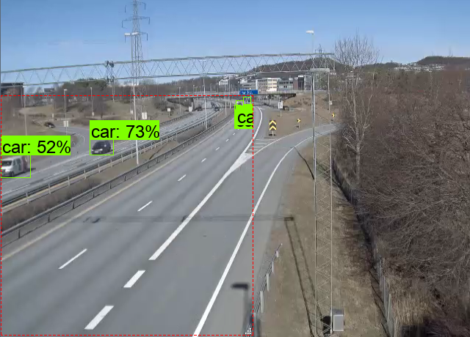
Outcome
Accuratelly detect and classify objects, mainly of the type car, bus, truck and bike.

Slide 7
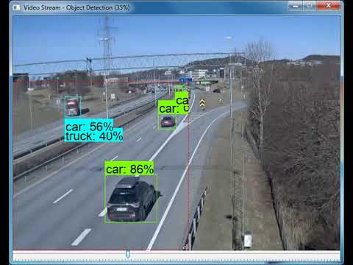
Demo

